Slide 1
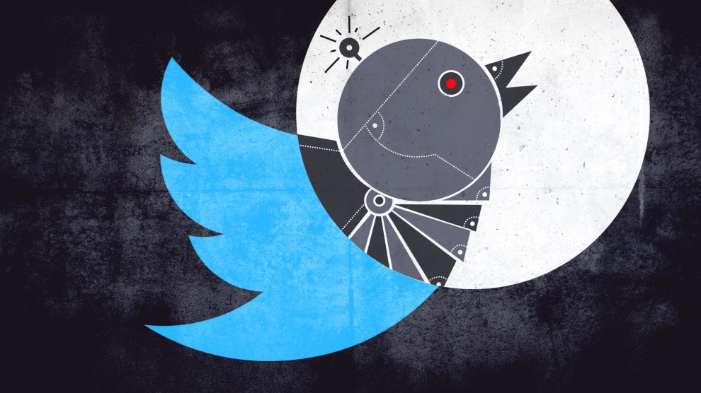
Twitter Analysis BOTorNOT Are there Russians in your tweets?
Text analysis of IRA Twitter data in the new cold war of
social engineering & disinformation

Slide 2
Team: John Carrola Mysti Downing
Quinn McIntire Aundrea Vickers

Slide 3


Slide 4
so· cial en· gi· neer· ing
/ˈsōSHəl ˌenjəˈni(ə)riNG/
noun
the use of centralized planning to manage social change and regulate the future development and behavior of a society

Slide 5
ma· nip· u· la· tion
/məˌnipyəˈlāSHən/
noun
the deliberate action of controlling or influencing (a person or situation) in a skillful manner, often in an unfair or unscrupulous way

Slide 6
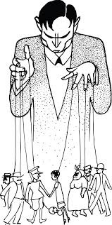
Дезинформация -> dezinformatsiya -> disinformation
literally a Russian term coined by Joseph Stalin, meaning false information spread deliberately to deceive or mislead public opinion

Slide 7
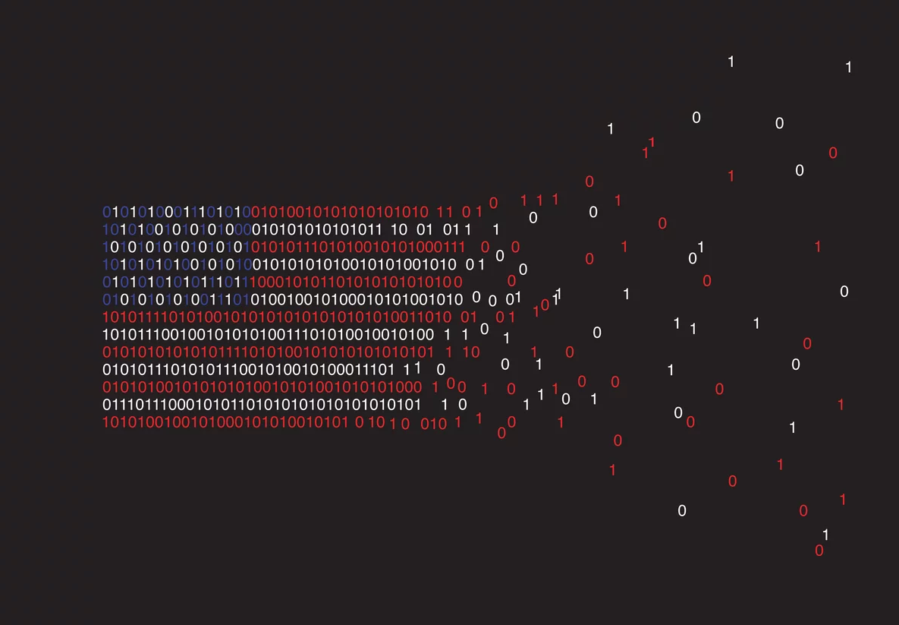

The Power of the Tweet
~68 million
US users
40% use daily
70% use for news
Image adapted from TIME magazine, Ben Wiseman; Statistics from Twitter & Pew Research Center

Slide 8
Data

Slide 9





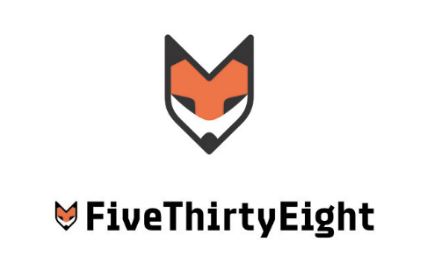

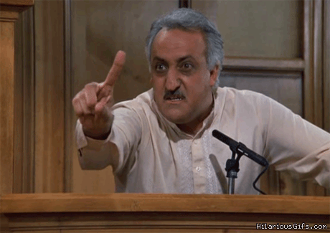
2,973,371 Tweets
2,848 H@ndles
Internet Research Agency (IRA)
"troll factory"
St Petersburg, Russia
Darren Linvill
Patrick Warren
FiveThirtyEight releases tweets on GitHub
July 31, 2018
Twitter deletes tweets and accounts of some known trolls
Linvill & Warren harvest, recreate, and categorize

Slide 10
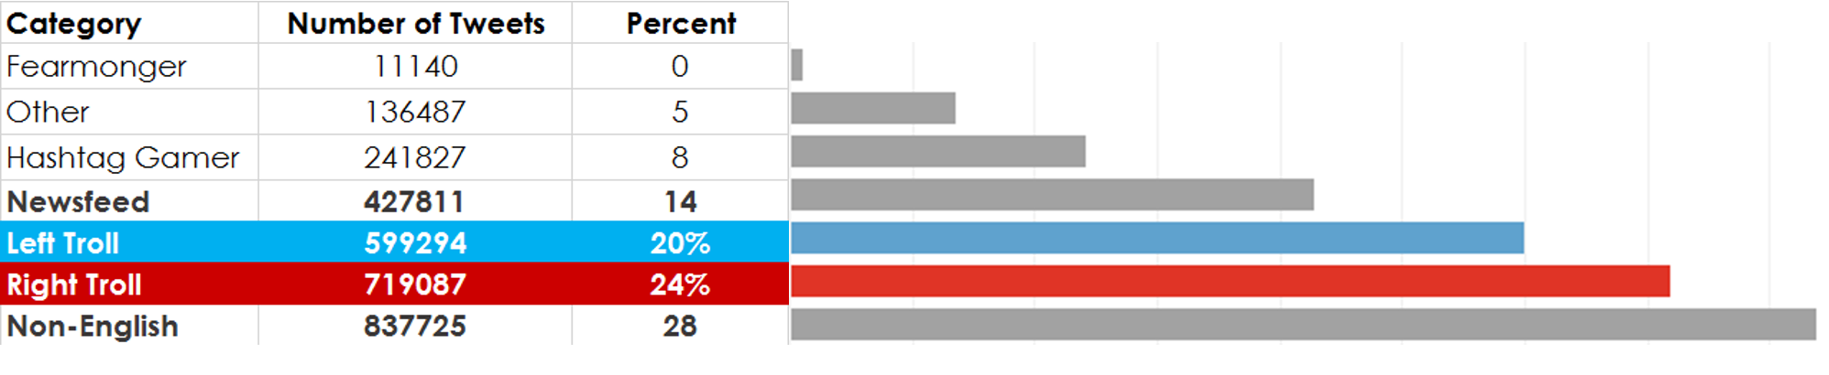
Summary of the Russian Troll Tweet Data

Slide 11
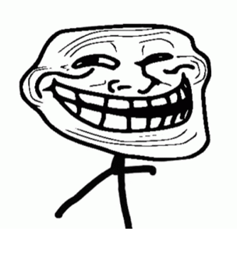
Another example of how all liberals are hateful, corrupt, lying, evil, deceitful, hypocritical, despicable pieces of s***
Nativist, populist messages
Uniformly support Trump
Denigrate the Democratic party
“Make America Great Again”, anti-immigrant
Devisive of mainstream and moderate Republicans
Profile pics of attractive young women
RT mb141bar: Dear Lord, protect, guide, bless our President Trump. Please save us from those attempting to harm him
Right
Trolls
(617)

Slide 12
Left
Trolls
(230)
Socially liberal
Focused on racial, sexual and religious identity
Mimicked Black Lives Matter
Attacked mainstream Democrats, especially Hillary
Support Bernie
@4mysquad And so #BLM is called a "hate group" while cops sworn to serve and protect commit murder, torture, aggravated assault and theft.'
Good Night Warriors! Remember White Supremacy Must be Destroyed Globally in order for True Peace & Real Justice to Reign.

Slide 13
Research Questions

Slide 14
What was talked about?
(topics)
When was it talked about?
(peak periods
& time of day)
How was it talked about?
(emotion
& sentiment)

Slide 15
Analysis Methods

Slide 16
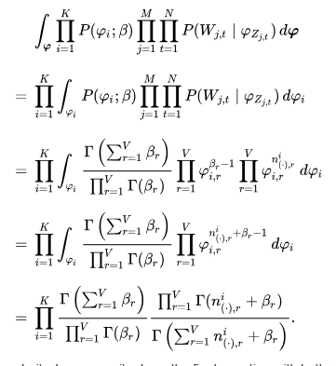
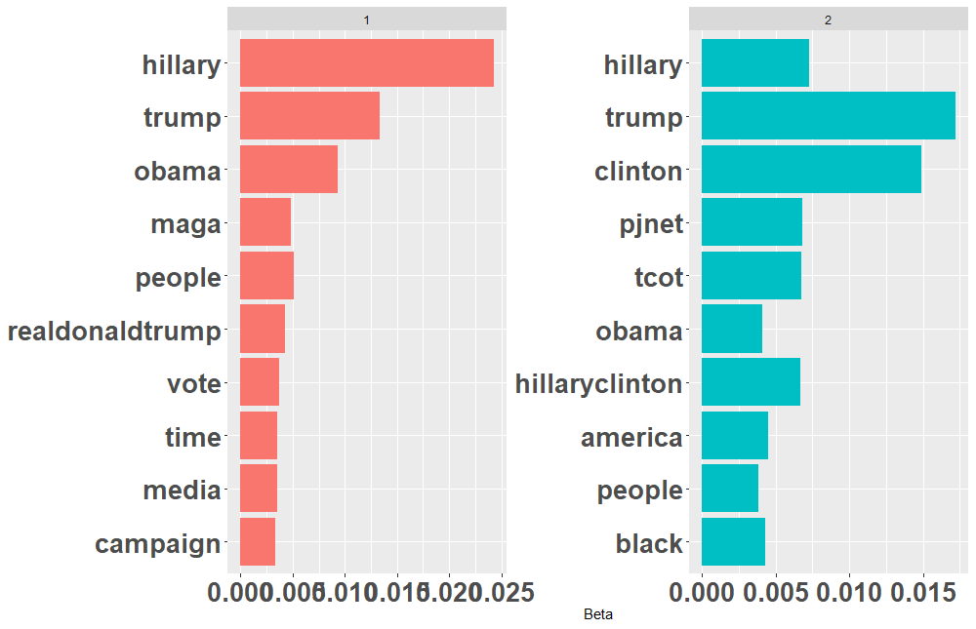

Latent Dirichlet Allocation (LDA)
R topicmodels package - unsupervised
Topic 1
Topic 2

Slide 17
Emotions & Sentiment
R Syuzhet package - implements Saif Mohammad’s NRC emotion lexicon
Emotion
Sentiment
 | anger | antici-pation | disgust | fear | joy | sadness | surprise | trust |  | negative | positive
RT mb141bar: Dear Lord, protect, guide, bless our President Trump.Please save us from those attempting to harm him https://t.co/mu8fHj1V50 | 0 | 1 | 1 | 1 | 2 | 0 | 1 | 5 |  | 2 | 7
Another example of how all liberals are hateful, corrupt, lying, evil, deceitful, hypocritical, despicable pieces of s*** like @HussamA https://t.co/6E0oT6pDPp | 5 | 0 | 7 | 2 | 0 | 3 | 0 | 0 |  | 8 | 0
Good Night Warriors! Remember White Supremacy Must be Destroyed Globally in order for True Peace & Real Justice to Reign. https://t.co/eLiMbwhD5L | 2 | 4 | 0 | 2 | 4 | 1 | 2 | 6 |  | 2 | 6
@4mysquad And so #BLM is called a "hate group" while cops sworn to serve and protect commit murder, torture, aggravated assault and theft.' | 6 | 1 | 4 | 5 | 0 | 4 | 1 | 1 |  | 7 | 1
Right
Left

Slide 18
Data Exploration

Slide 19
Peak Periods

Slide 20
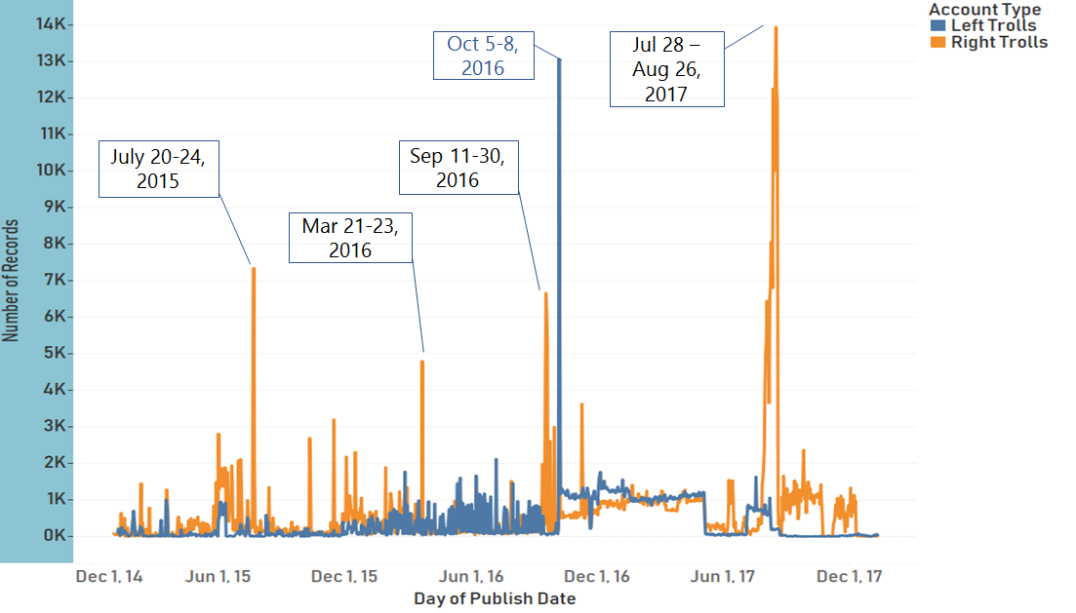
Overall IRA Troll Tweets 2015 - 2017
Notes:
- As we first looked at the tweets for just the Left and Right trolls, these 5 peaks stood out over more than 5K tweets per day up to 14K per day (4-10 per minute)
- Four for the right trolls (July 20-24, 2015, Mar 21-23, 2016, Sept 11-30, 2016, July 28 – Aug 26, 2017)
- One for the left trolls (Oct 5-8, 2016)
- Using some of the techniques described, what could we find out about the emotion, sentiment, and topics of these times

Slide 21
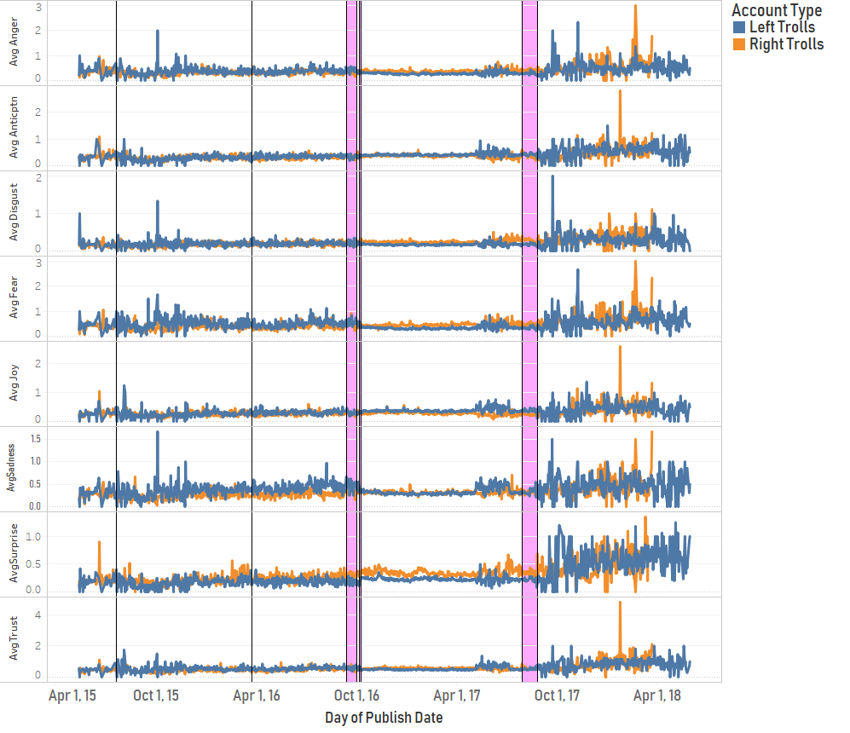
Emotions Analysis During Peak Tweet Periods
July 20-24, 2015
Mar 21-23, 2016
Sep 11-30, 2016
Oct 5-8, 2016
Jul 28 – Aug 26, 2017
Avg Anger
Avg Anticipation
Avg Disgust
Avg Fear
Avg Joy
Avg Sadness
Avg Surprise
Avg Trust
Differences in emotion during peak periods were similar to trends before and after
Notes:
- First, we looked at emotion over the each of the periods
- We devised a measure that you're seeing here and will see in future visualizations around average per tweet, so these are average emotion per tweet
- We thought we might see a spike or dip in certain emotional uses during these periods.
- We didn't but you can see that there are some differences in troll values that occur both before, during, and after peak tweet periods
- For instance, we see that surprise and fear were used more heavily on average by Right trolls

Slide 22
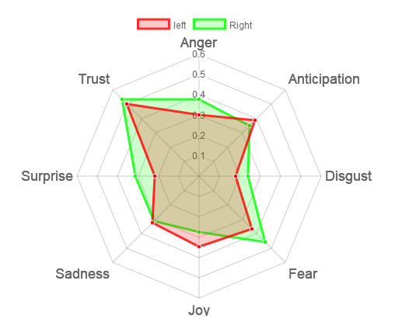
Average Emotion 2015-2017
Fear, Surprise, and Anger emotions trended slightly higher for Right trolls
Joy trended slightly higher for Left trolls
Notes:
- If we look at average emotion per tweet over the range of all the tweets, right trolls use fear, surprise, and anger to a slightly greater degree than left trolls
- Left trolls tweets exhibit a slightly higher use of the joy emotion overall

Slide 23
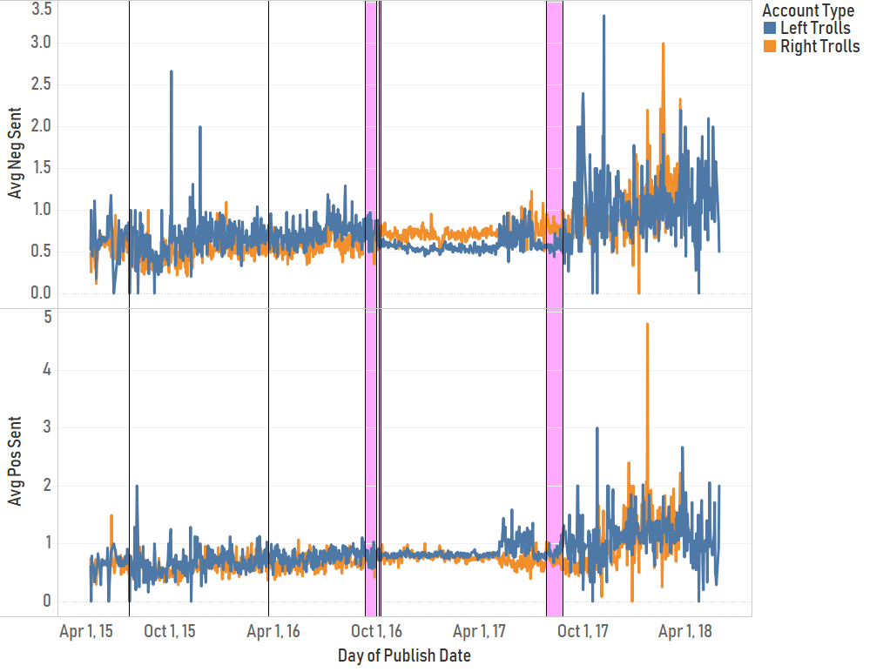
Sentiment Analysis During Peak Tweet Periods
July 20-24, 2015
Mar 21-23, 2016
Sep 11-30, 2016
Oct 5-8, 2016
Jul 28 – Aug 26, 2017
Avg Negative Sentiment
Avg Positive Sentiment
Differences in sentiment during peak periods were similar to trends before and after
Notes:
- Likewise when we looked at sentiment (which has some similarity to emotion but scored differently), we don't see sharp spikes during the peak periods
- But we do see higher average negative sentiment for right troll tweets in the period leading up to the 2016 election and in the following year

Slide 24
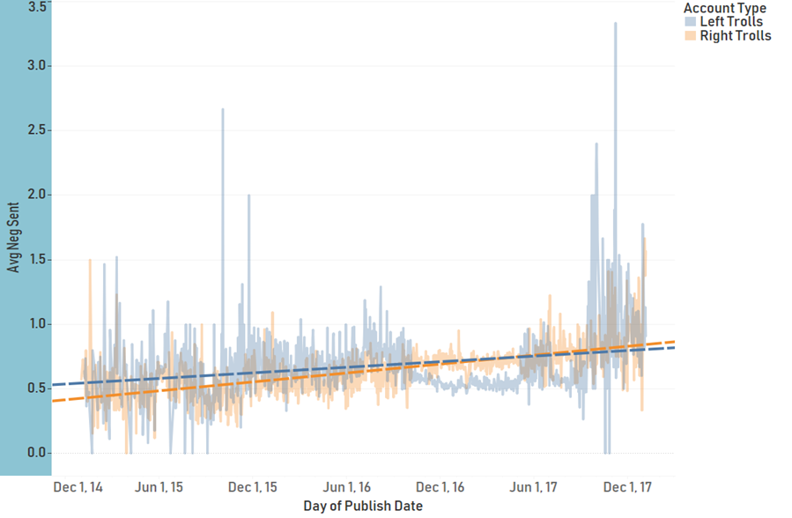
Negative Sentiment Left/Right Trolls 2015-2017
Left Trolls started with a higher degree of negative sentiment but were overtaken by Right Trolls shortly after the Nov 2016 election
Notes:
- Here is the negative sentiment trend for Left and Right trolls over the roughly 3 years. Negative sentiment is increasing for both troll types by increased faster for right trolls especially as election time neared

Slide 25
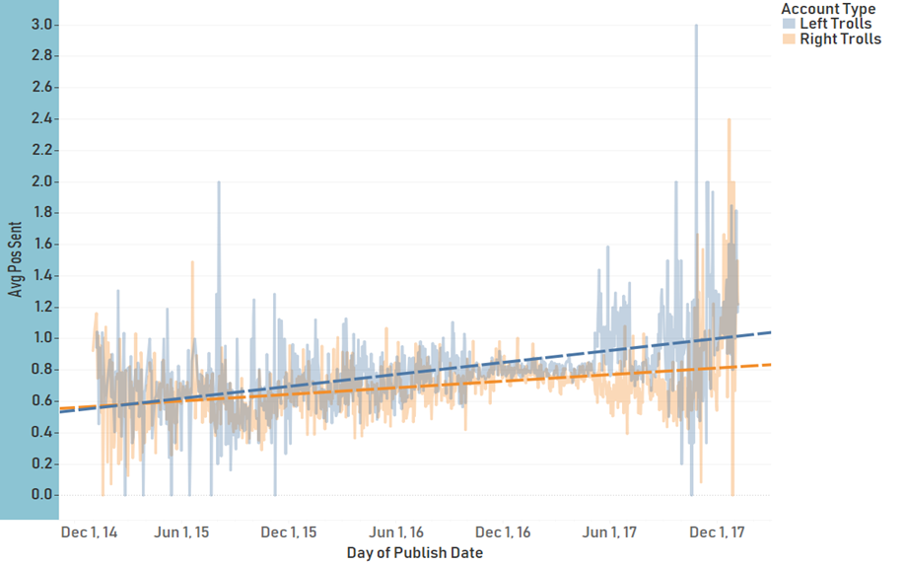
Positive Sentiment Left/Right Trolls 2015-2017
Positive sentiment increased at twice the rate for Left Trolls than for Right Trolls
Notes:
- Likewise, positive sentiment increased for both left and right rolls
- The rate of increase was significantly faster for left trolls
- If there's a message from the positive and negative sentiment trends it's that they're going up for both troll types.
- One theory is that the trolls may be finding they need to use more impassioned messaging to get the same response

Slide 26
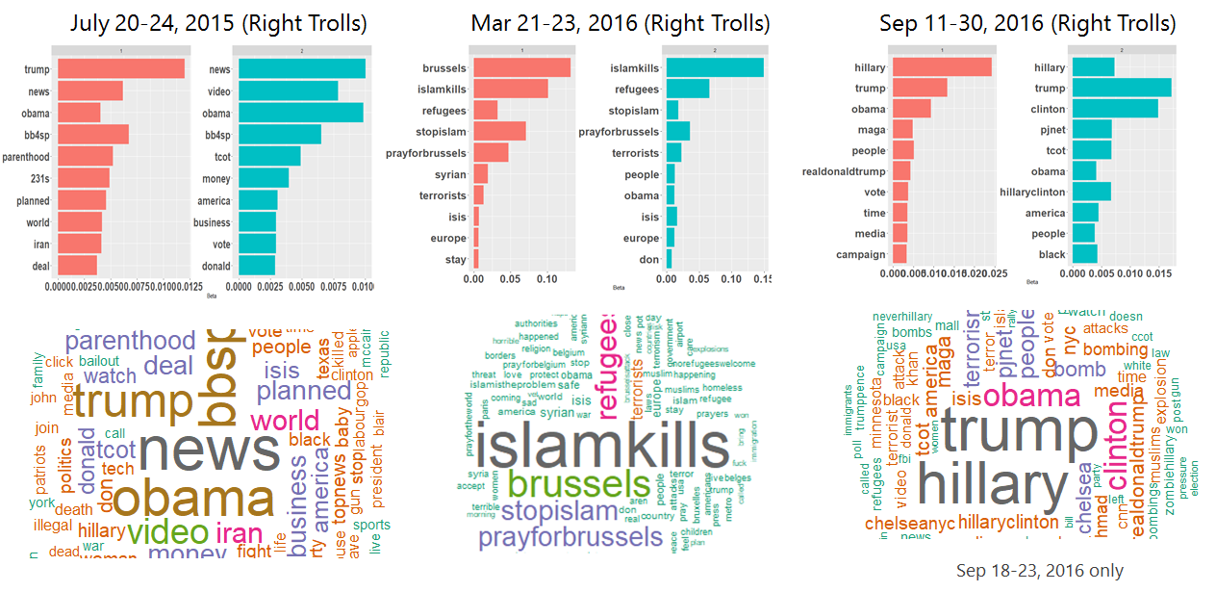
Peak Period Topic Analysis
Tweets around the Mar 22, 2016 Brussels terror attacks exhibited strong anti-Islamic bias
Notes:
Tweets around the Mar 22, 2016 Brussels terror attacks exhibited strong anti-Islamic bias
Tweets around the Mar 22, 2016 Brussels terror attacks exhibited strong anti-Islamic bias

Slide 27
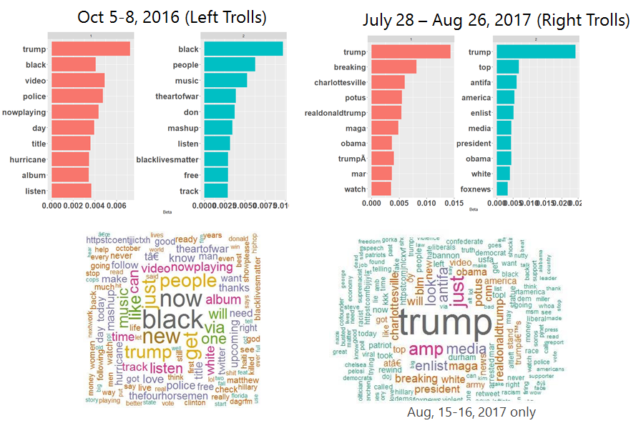
Peak Period Topic Analysis
High traffic before, during and after Aug 11-12, 2017 Charlottesville, VA Unite the Right Rally

Slide 28
Times of Day

Slide 29
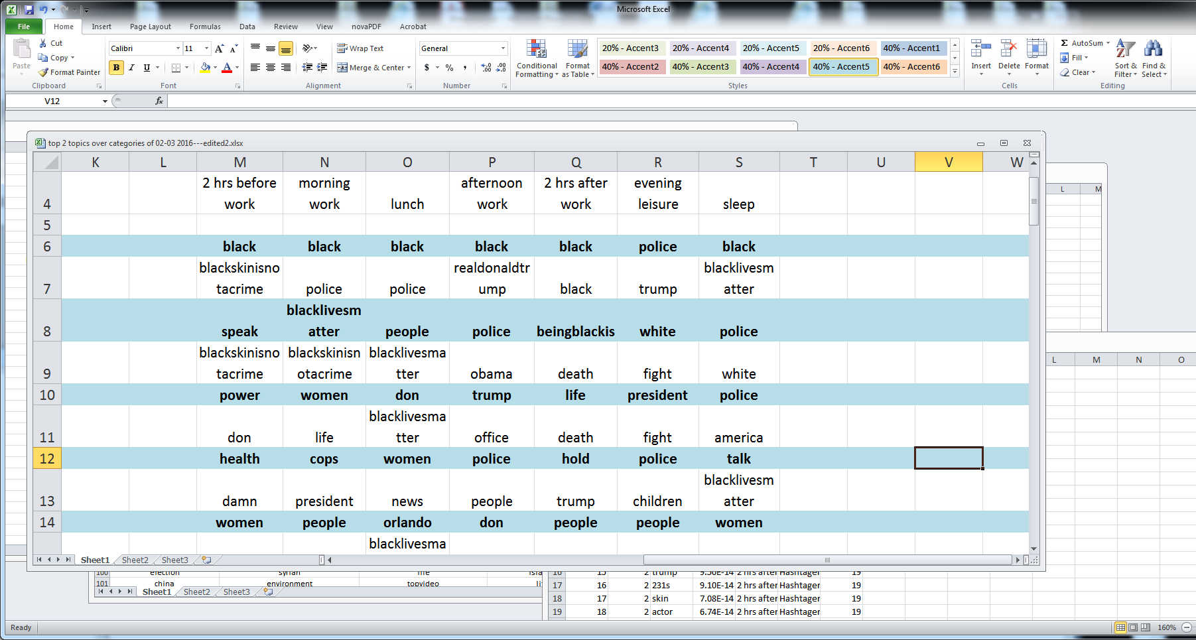
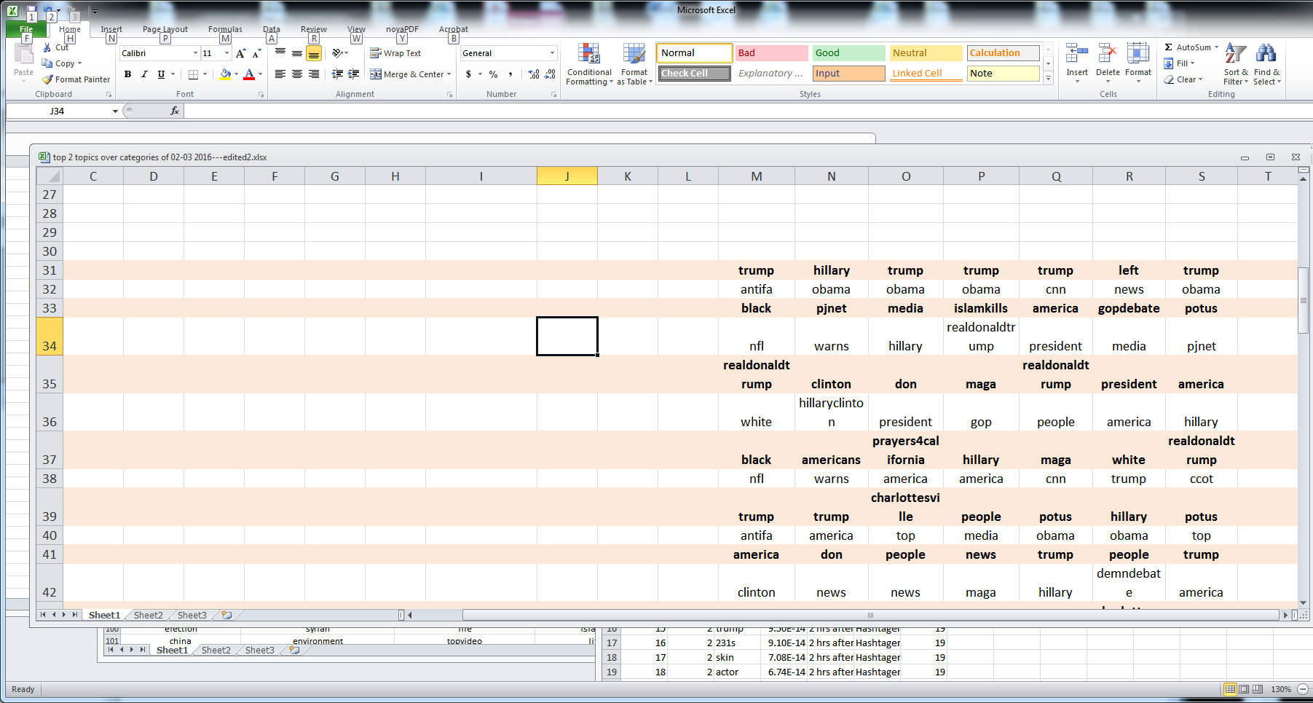
Time Defined by Hours of Workday Productivity
Were there certain times the trolls wanted the most people viewing their messages
lunch
2 hrs after work
sleep
2 hrs before work
evening leisure
morning work
afternoon work
Time
Left Troll
Topics
Right Troll

Slide 30
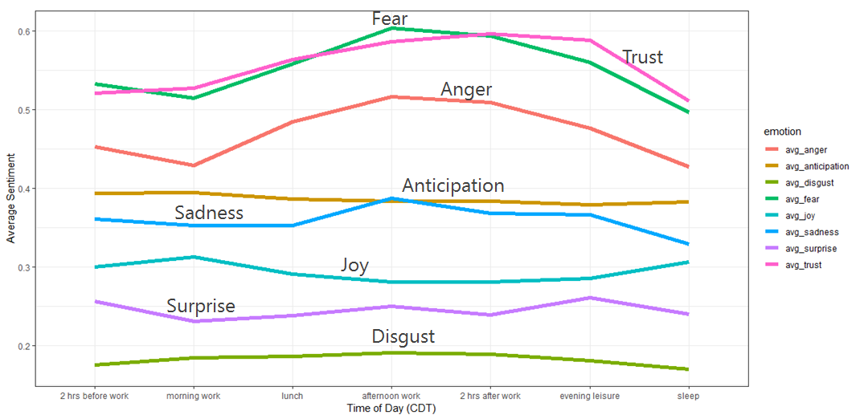
Average Emotion usage per time of day
This visual details the changes in the amount of emotions used in the messages
Over the entire tweet set:
Tweets exhibit greater degrees of fear, anger, and trust than other emotions

Slide 31
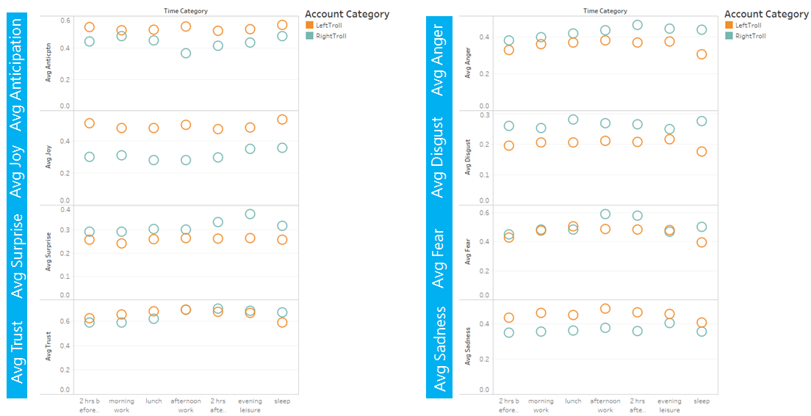
Emotional appeal per time of day…
At what times of day and what emotions are being presented to us
The Russian Right and Left Trolls had similar goals even if targeted groups differed:
Used the main emotions of Fear, Trust and Anger similarly –they seemed to send the Right to bed with higher levels of these emotions!
Notes:
Interesting to note why usage in certain emotions diverged at certain times: Strategic intent or variability among the Troll authors

Slide 32
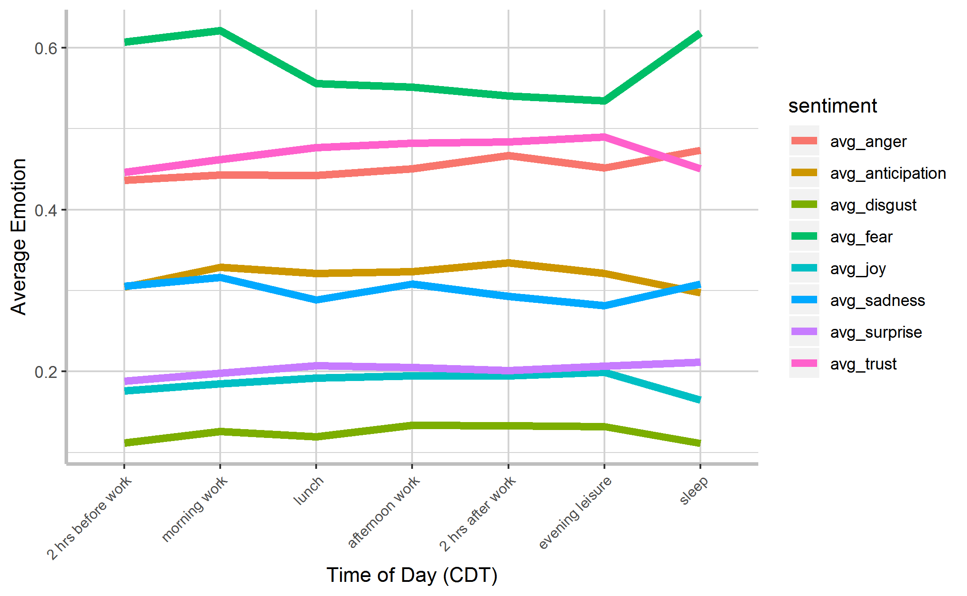


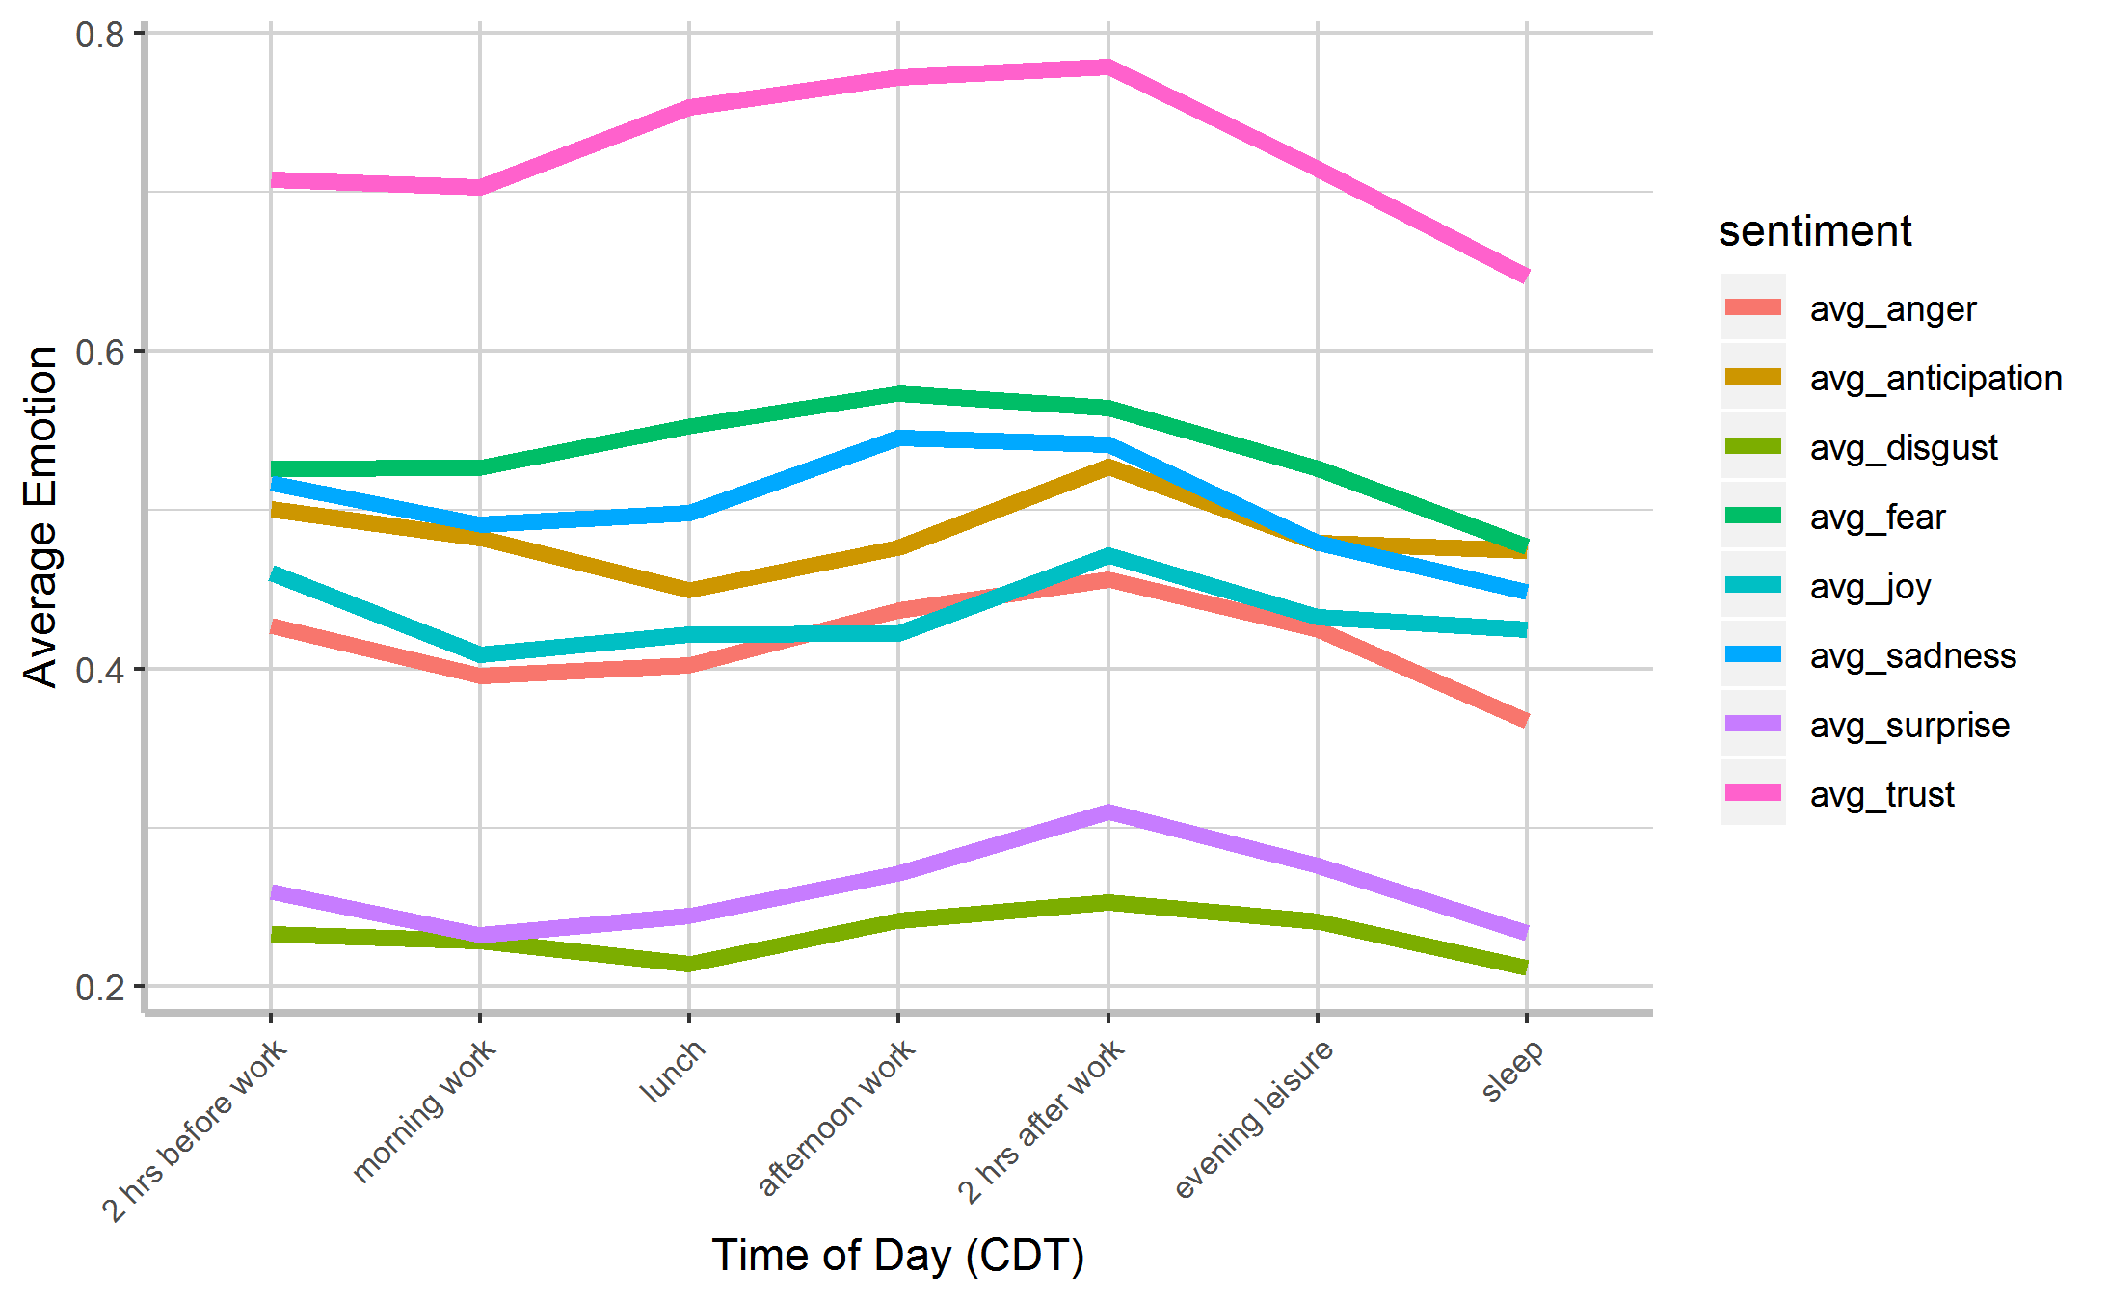
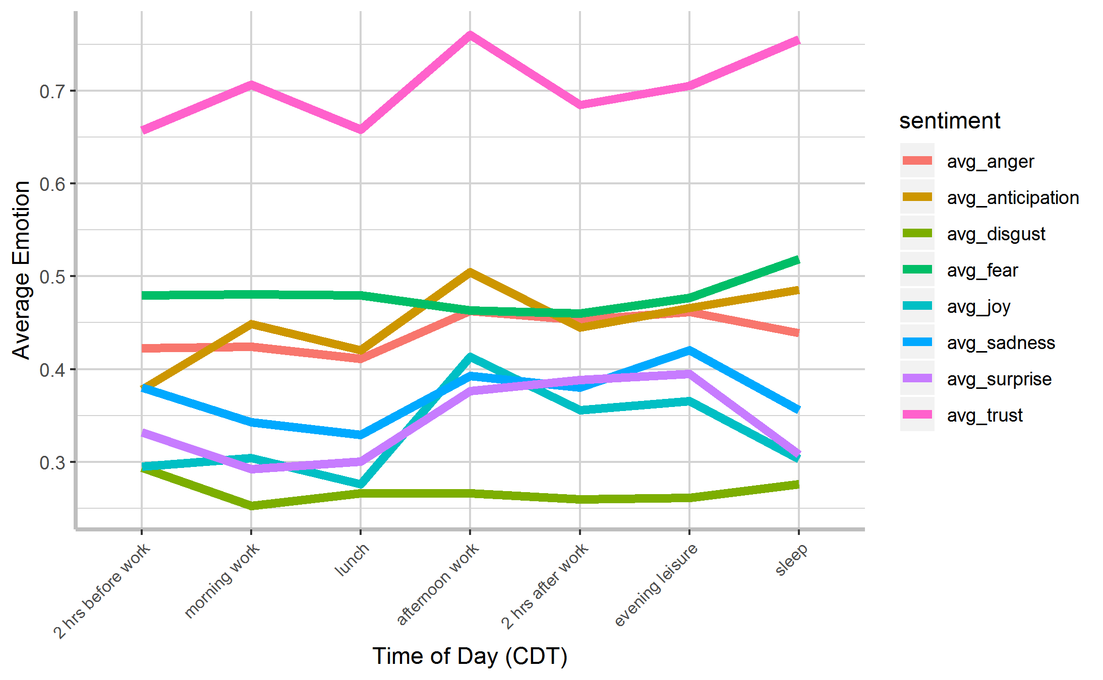

Topics Presented over Time of Day (Defined By Productivity Hours)
Understanding social engineering strategies by visualizing What, When, Emotion usage
Left Troll
Repeating Topics over the day common (Typical behavior or purposeful)
Right Troll
Pattern of infusing messages with trust and fear over others emotions
2 hrs before work
lunch
sleep
lunch
2 hrs after work
sleep
afternoon work
2 hrs after work
2 hrs before work
afternoon work
morning work
evening leisure
morning work
evening leisure
Time
Topics
Trust
Trust
Fear
Sadness
Average Emotions To Topics
Anticipation
Fear
Anticipation
Joy
Anger
Sadness
Anger
Joy
Surprise
Surprise
Disgust
Disgust

Slide 33
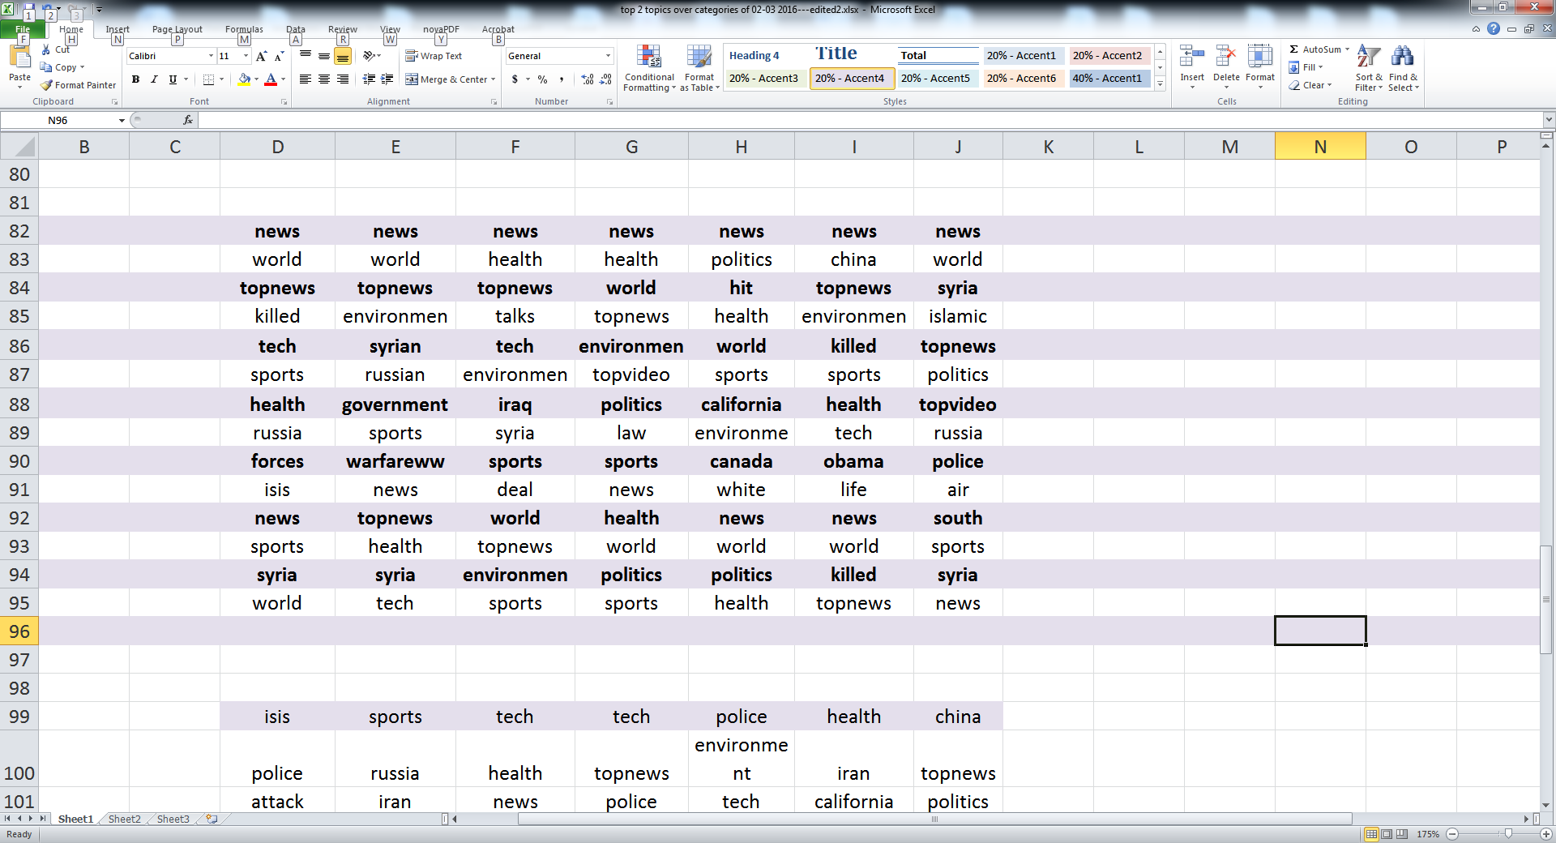
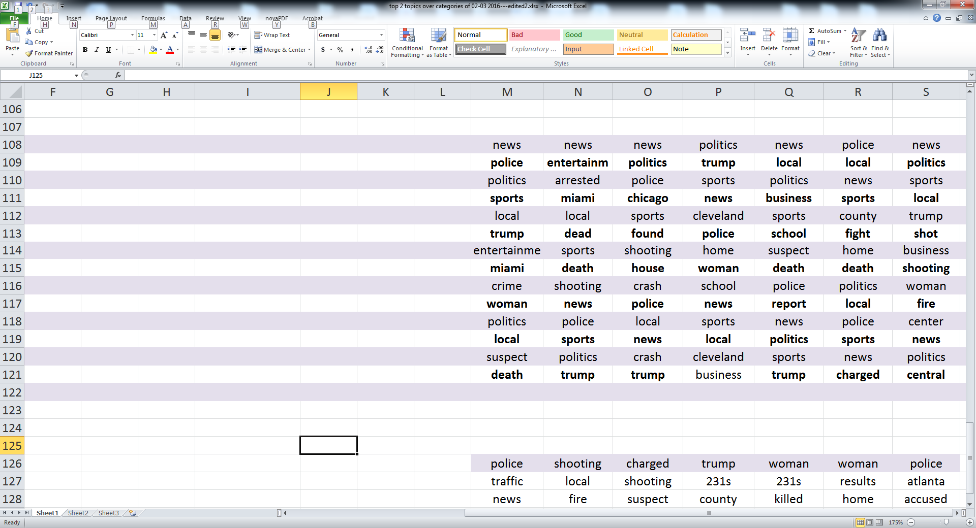
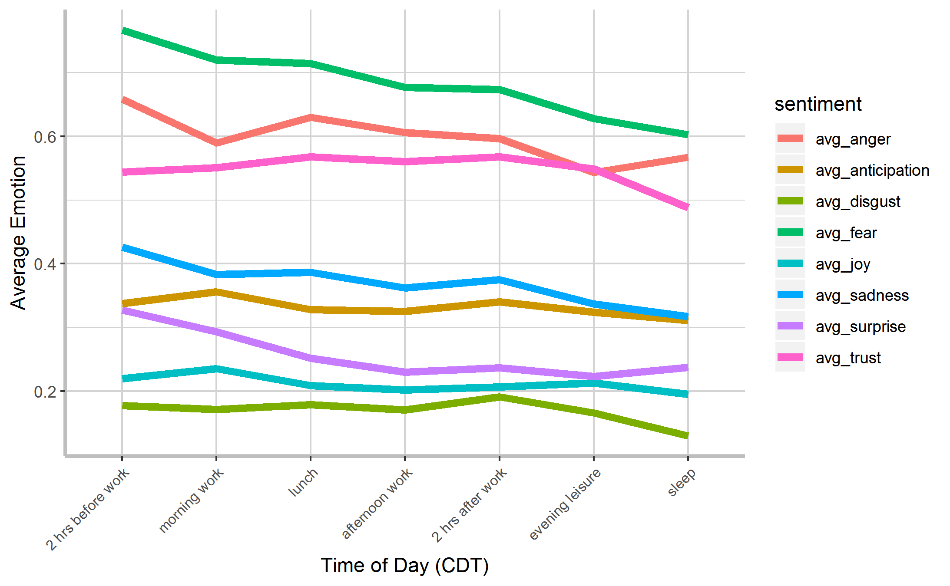
Topics Presented over Time of Day (Defined By Productivity Hours)
Pattern of emotions used by disinformation news Trolls provided content high in fear, anger, and trust (mistrust?)
Directed fear and anger inducing stories to audiences primed to receive it
News
Local
2 hrs before work
lunch
sleep
afternoon work
sleep
lunch
afternoon work
2 hrs after work
morning work
evening leisure
morning work
evening leisure
2 hrs before work
2 hrs after work
Time
Topics
Fear
Fear
Trust
Anger
Anger
Trust
Average Emotions To Topics
Anticipation
Sadness
Sadness
Surprise
Surprise
Anticipation
Joy
Disgust
Joy
Disgust

Slide 34
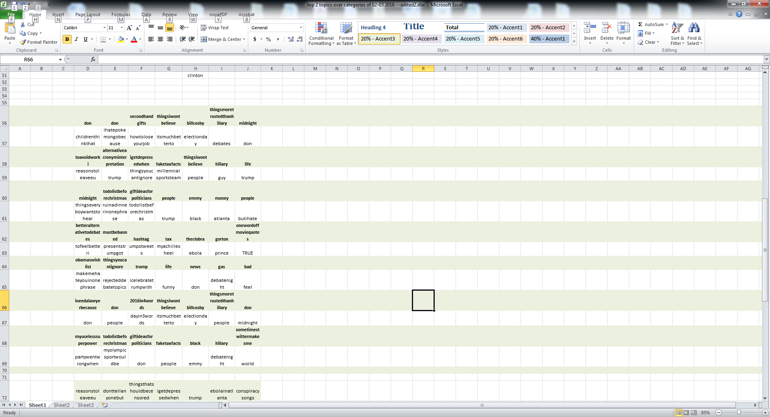
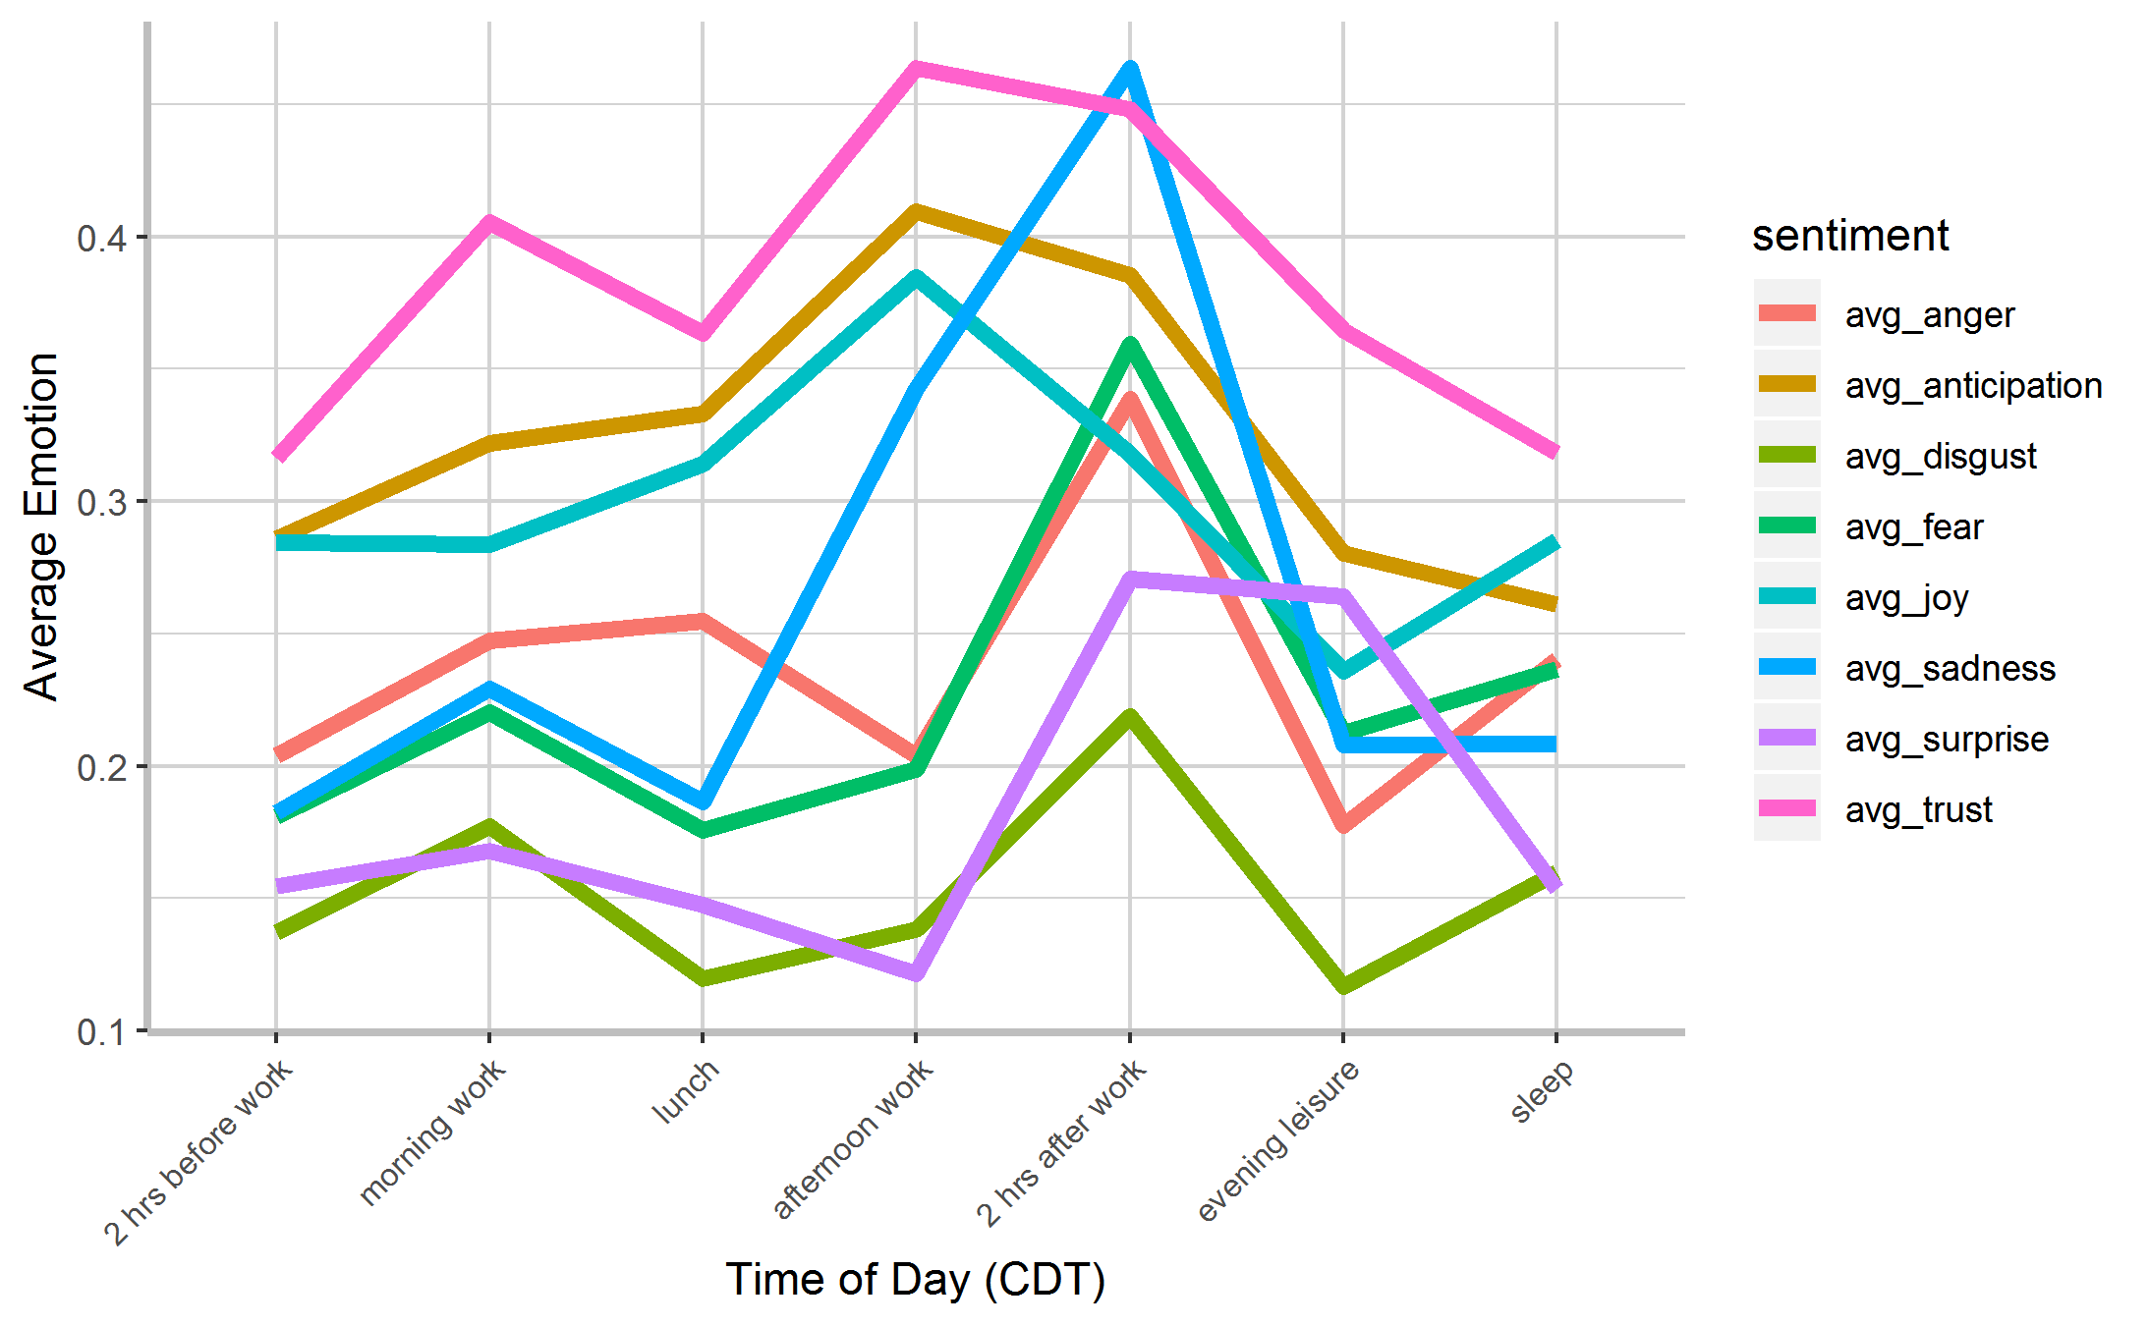
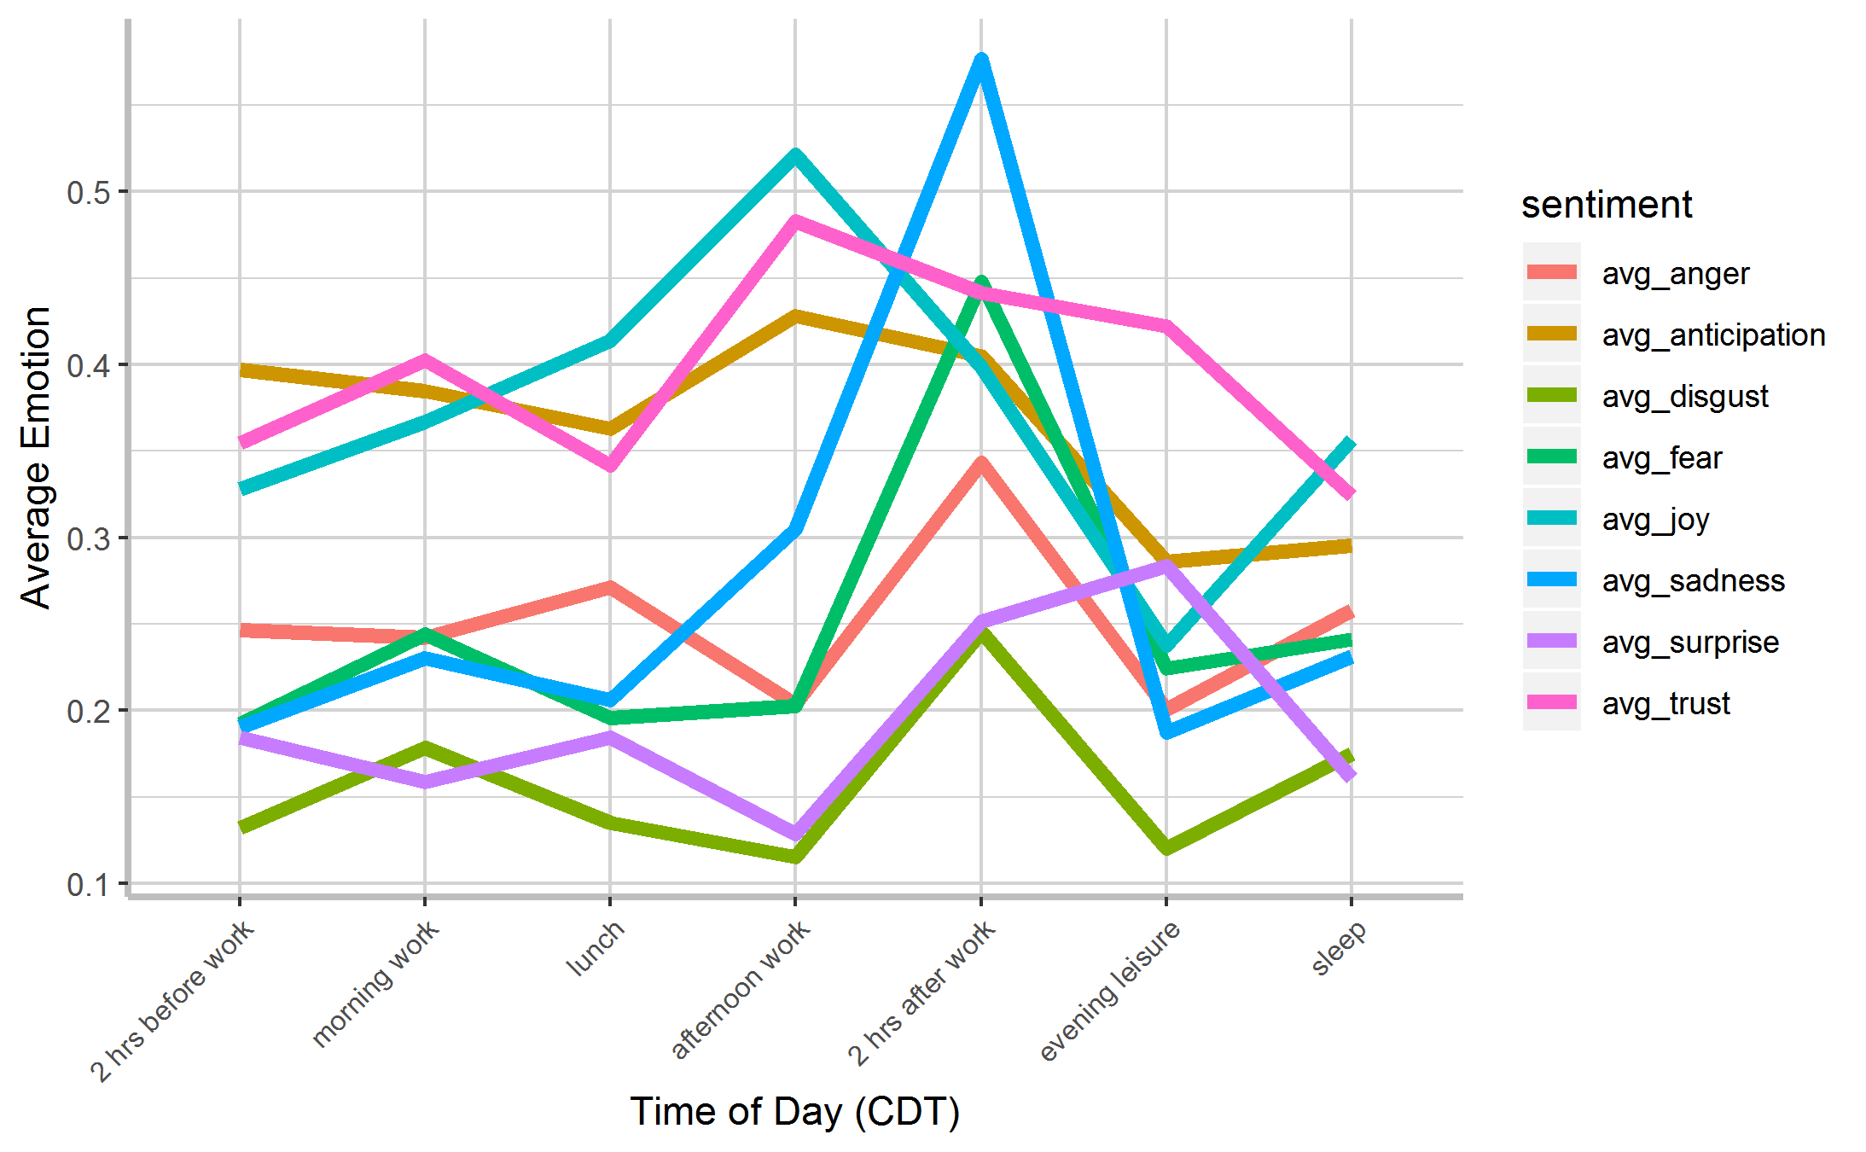
Topics Presented over Time of Day (Defined By Productivity Hours)
afternoon work
sleep
lunch
2 hrs before work
morning work
evening leisure
Time
2 hrs after work
Visualizing the HashTagGamer troll—a group trying to trend hashtag topics—noticed unique and consistent pattern of emotion usage
Topics
Consistent pattern may be a fingerprint to identify automation and disinformation on social media
Sadness
Apply machine learning on these patterns to help differentiate between bots and humans
Trust
HashTagGamer Troll
Fear
Anticipation
Joy
Average Emotions To Topics
Anger
Surprise
Disgust

Slide 35
Insights & Conclusions

Slide 36
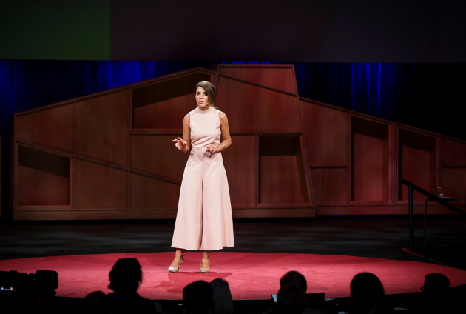
Open minds & free expression -> our greatest vulnerability
Modern state-sponsored information operation
Sensational narratives amplified in social media
‘Reflexive control’
Laura Gallante, security expert in how states use cyberspace
TED Talk, May 2017
The mind is the most exploitable device on the planet

Slide 37
The US populace is being manipulated through social media by foreign powers, such as Russia
This social engineering strategy is not just related to the 2016 election, but is on-going
The techniques being used are sophisticated and subtle
We should develop machine learning applications to detect early signs of large scale disinformation campaigns

Slide 38
Our best DEFENSE is the ability to think critically, to call out falsehoods, and above all, to have the courage to unflinchingly pursue the truth.

Slide 39


